Slide 1
Labs
Packet Tracer

Slide 2
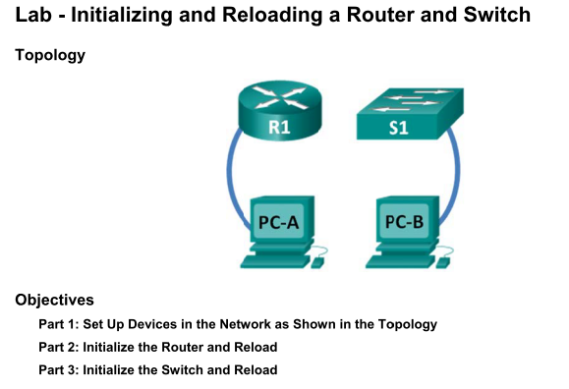
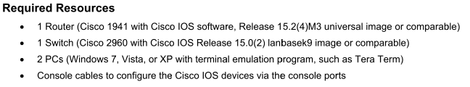
LAB-1

Slide 3
LAB-1: Initialize the Router and Reload
Step 1: Connect to the router.
  Console into the router and enter privileged EXEC mode using the enable command.
  Router> enable
  Router#
Step 2: Erase the startup configuration file from NVRAM.
  Type the erase startup-config command to remove the startup configuration from nonvolatile random-access memory (NVRAM).
  Router# erase startup-config
  Erasing the nvram filesystem will remove all configuration files! Continue? [confirm] Y
  Erase of nvram: complete
  Router#
Step 3: Reload the router.
  Issue the reload command to remove an old configuration from memory. When prompted to Proceed with reload, press Enter to confirm the reload. Pressing any other key will abort the reload.
  Router# reload
  Proceed with reload? [confirm] <CR>
  *Nov 29 18:28:09.923: %SYS-5-RELOAD: Reload requested by console. Reload Reason: Reload Command.

Slide 4
LAB-1: Initialize the Switch and Reload
Step 1: Connect to the switch.
  Console into the switch and enter privileged EXEC mode using the enable command.
  Switch> enable
  Switch#
Step 2: Determine if there have been any virtual local-area networks (VLANs) created.
  Use the show flash command to determine if any VLANs have been created on the switch.
  Switch# show flash
  Directory of flash:/
  2 -rwx 1919 Mar 1 1993 00:06:33 +00:00 private-config.text
  3 -rwx 1632 Mar 1 1993 00:06:33 +00:00 config.text
  4 -rwx 13336 Mar 1 1993 00:06:33 +00:00 multiple-fs
  5 -rwx 11607161 Mar 1 1993 02:37:06 +00:00 c2960-lanbasek9-mz.150-2.SE.bin
  6 -rwx 616 Mar 1 1993 00:07:13 +00:00 vlan.dat
  32514048 bytes total (20886528 bytes free)
  Switch#

Slide 5
LAB-1: Initialize the Switch and Reload
Step 3: Delete the VLAN file.
  If the vlan.dat file was found in flash, then delete this file.
  Switch# delete vlan.dat
  Delete filename [vlan.dat] ? <CR>
  When you are prompted to delete this file, press Enter to confirm the deletion. (Pressing any other key will abort the deletion.)
  Switch#
Step 4: Erase the startup configuration file from NVRAM.
  Type the erase startup-config command to remove the startup configuration from nonvolatile random-access memory (NVRAM).
  Switch# erase startup-config
  Erasing the nvram filesystem will remove all configuration files! Continue? [confirm] Y
  Erase of nvram: complete
Step 5: Reload the switch.
  Issue the reload command to remove an old configuration from memory. When prompted to Proceed with reload, press Enter to confirm the reload. Pressing any other key will abort the reload.
  Switch# reload
  Proceed with reload? [confirm] <CR>

Slide 6
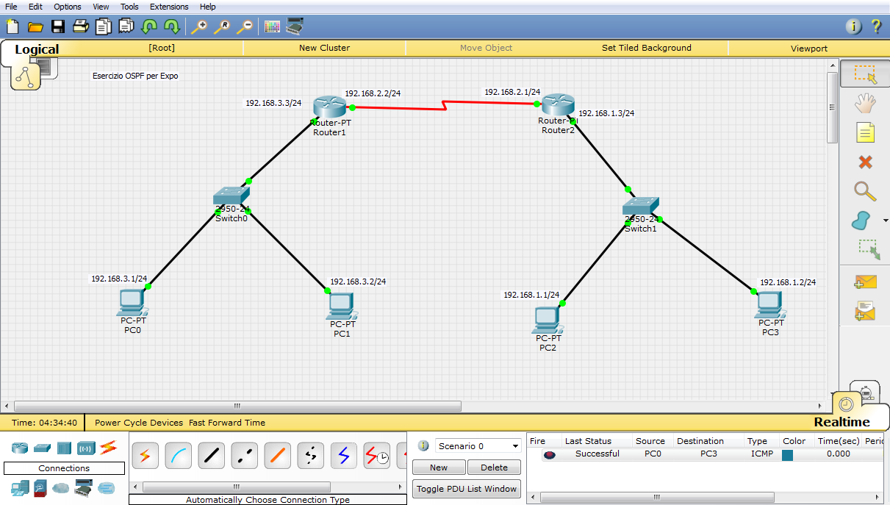

Slide 7
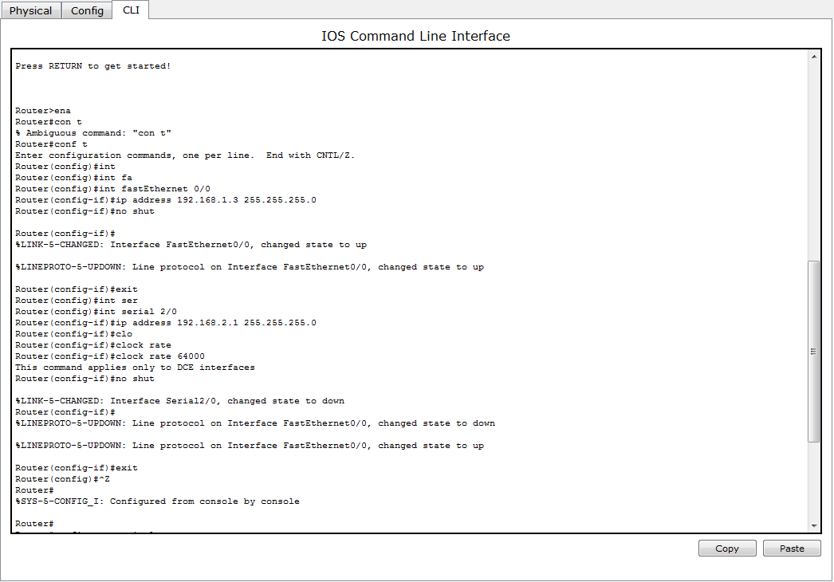

Slide 8
Lab-2: Password authentication protocol on packet tracer
The Point-to-Point Protocol (PPP) is a data link protocol commonly used in establishing a direct connection between two networking nodes. It can provide connection authentication, transmission encryption and compression.
PAP
A password authentication protocol (PAP) is an authentication protocol that uses a password. PAP is used by Point to Point Protocol to validate users before allowing them access to server resources. Almost all network operating system remote servers support PAP.
PAP transmits unencrypted ASCII passwords over the network and is therefore considered insecure. It is used as a last resort when the remote server does not support a stronger authentication protocol, like CHAP or EAP (the latter is actually a framework).
Password-based authentication is the protocol that two entities share a password in advance and use the password as the basis of authentication.
PAP works basically the same way as the normal login procedure. The client authenticates itself by sending a user name and an (optionally encrypted) password to the server, which the server compares to its secrets database. This technique is vulnerable to eavesdroppers who may try to obtain the password by listening in on the serial line, and to repeated trial and error attacks.

Slide 9
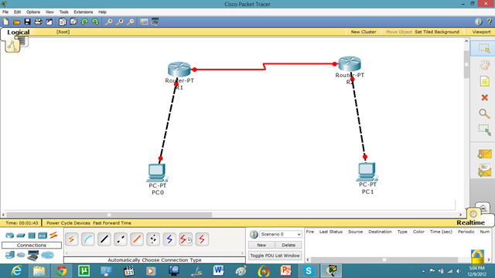
Lab-2 Network

Slide 10
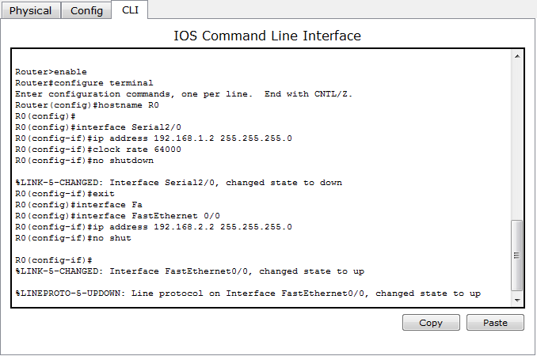
Lab-2: R0 IP configuration

Slide 11
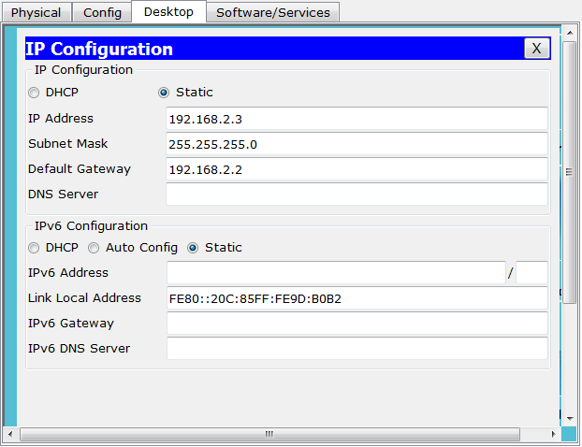
Lab-2: PC1 IP configuration

Slide 12
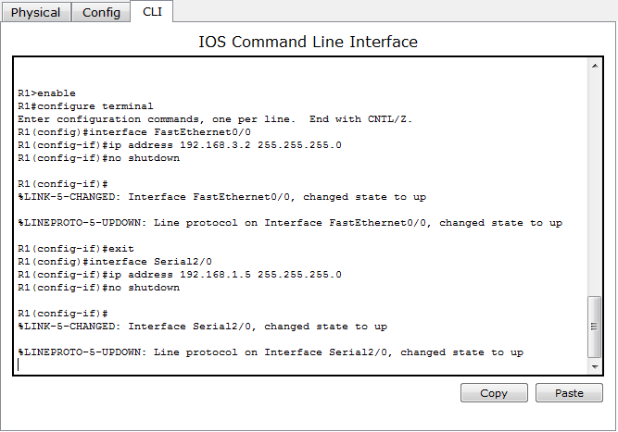
Lab-2: R1 IP configuration

Slide 13
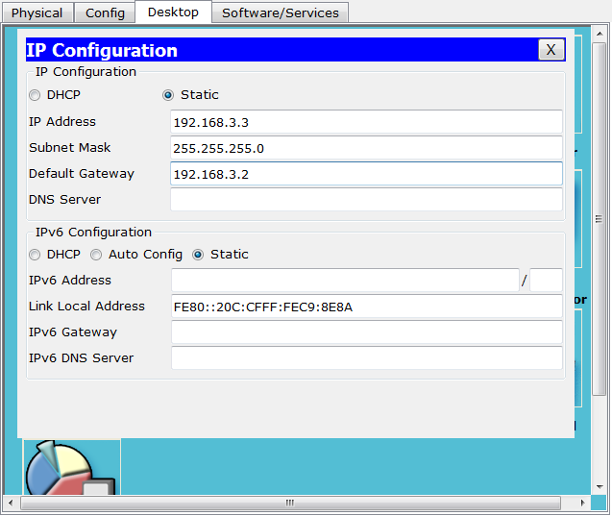
Lab-2: PC IP configuration

Slide 14
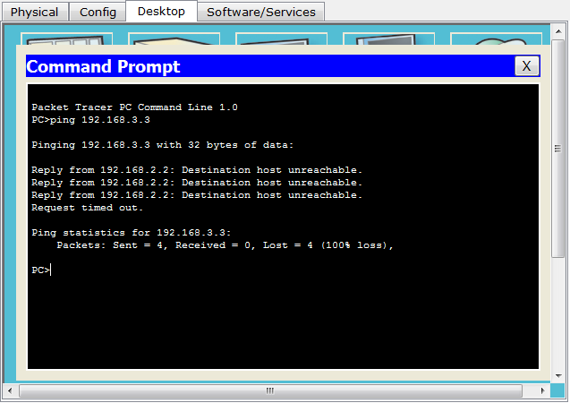
Now, we know that PCs that are attached cannot communicate until we apply a routing mechanism. In this case we are applying the RIP V2 protocol.

Slide 15
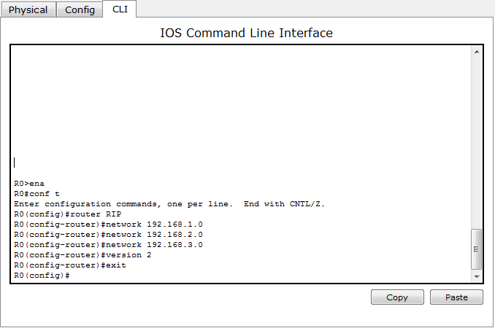
Lab-2: R0 RIP configuration

Slide 16
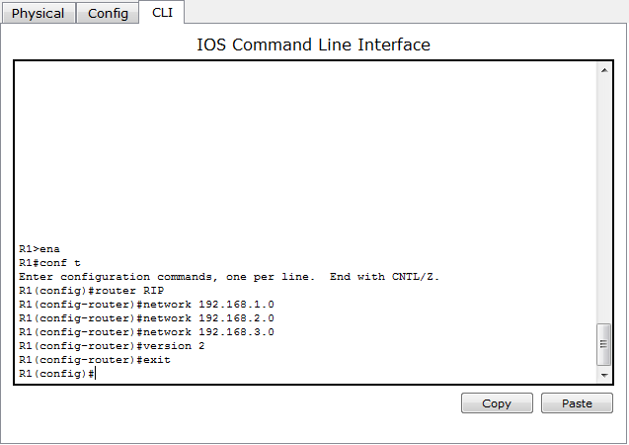
Lab-2: R1 RIP configuration

Slide 17
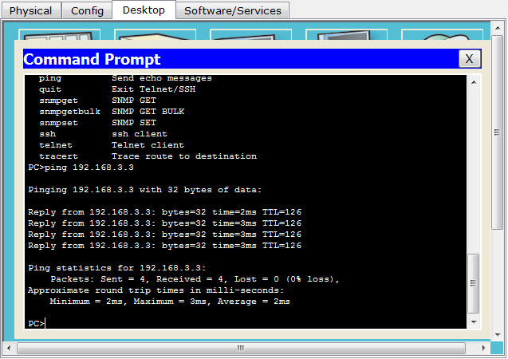
Lab-2: Connection test

Slide 18
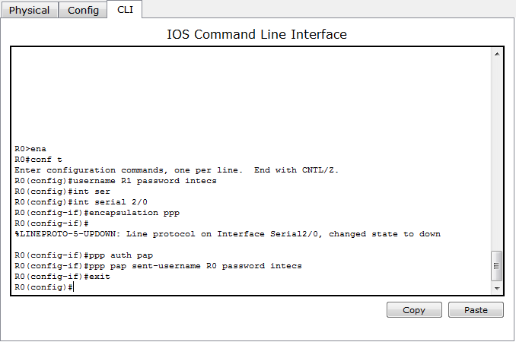
Lab-2: R0 PAP configuration

Slide 19
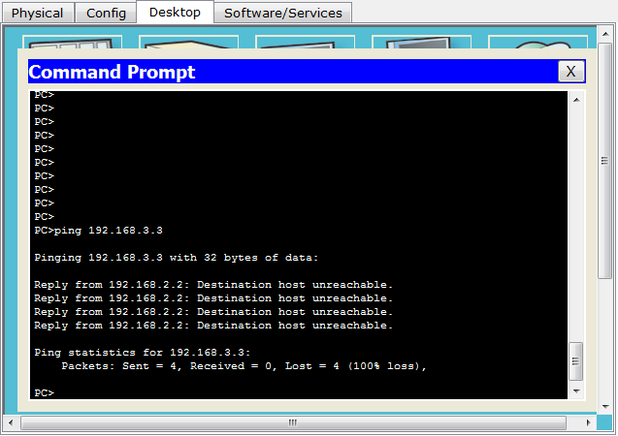
Lab-2: Connection test
As we set the authentication on one router the communication is disabled.

Slide 20
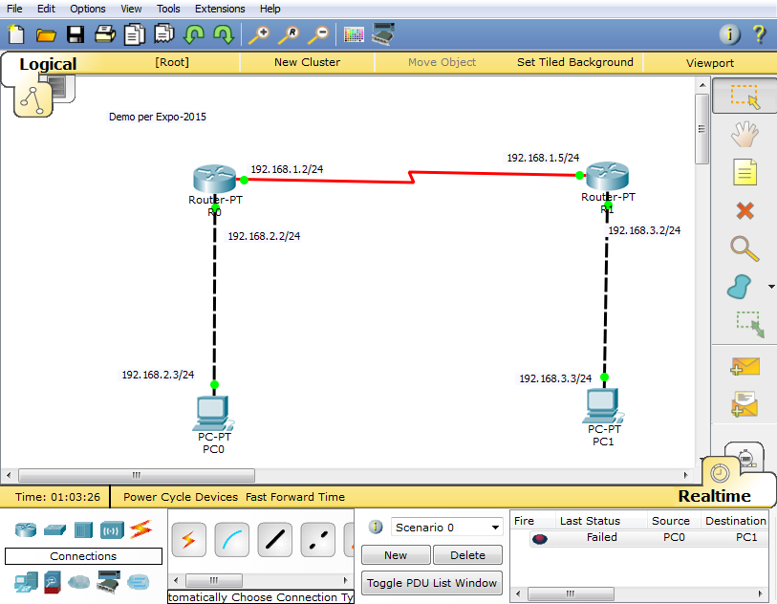

Slide 21
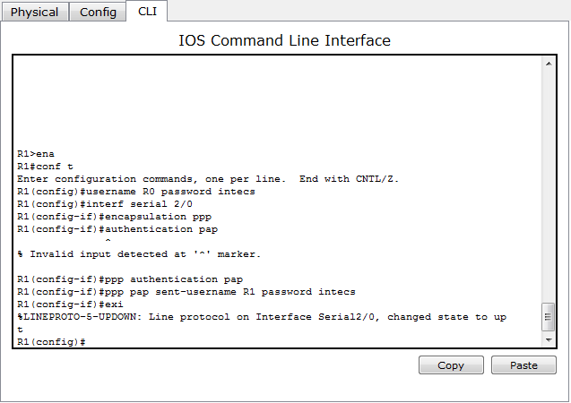
Lab-2: R1 PAP configuration

Slide 22
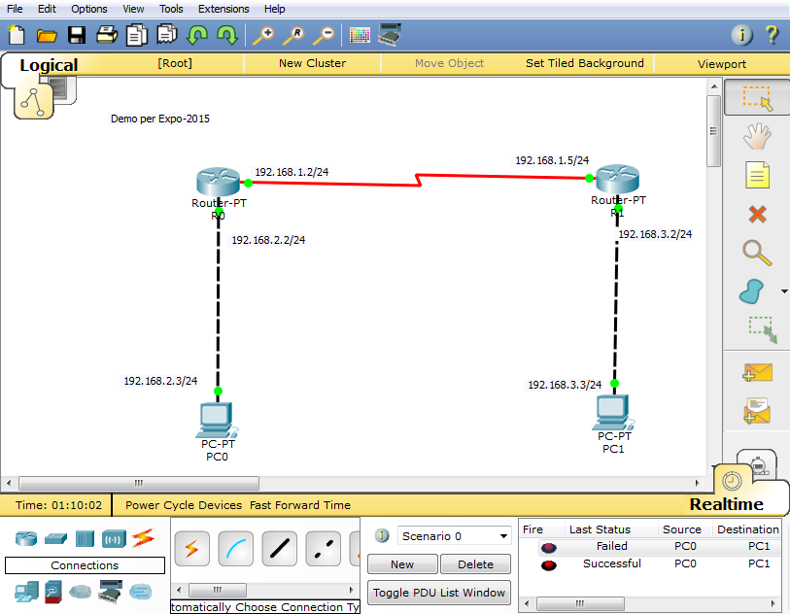
Lab-2: Connection test

Slide 23
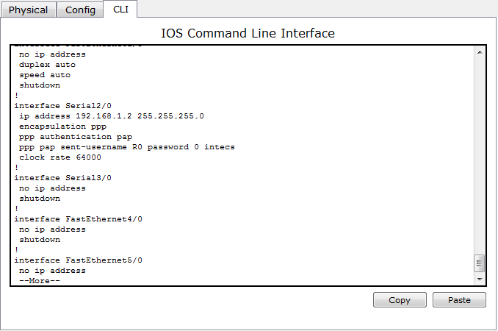
Now, if we run show run command in enable mode. We can see the authentication enabled in router.
Autenticazione sul Router R0

Slide 24
Tutorial: DHCP on Packet Tracer
This tutorial is about how to configure dhcp on cisco router in packet tracer. The DHCP server maintains a database of available IP addresses and configuration information. When it receives a request from a client, the DHCP server determines the network to which the DHCP client is connected, and then allocates an IP address. DHCP servers typically grant IP addresses to clients only for a limited interval.
Lets apply DHCP on packet tracer.

Slide 25
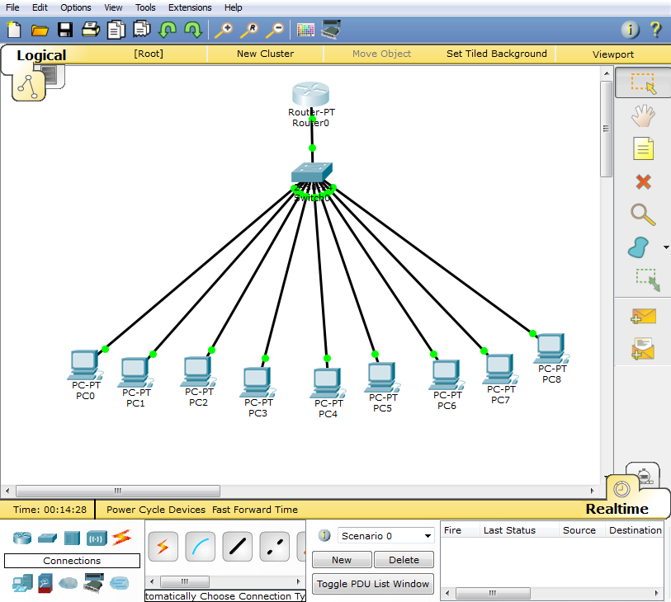

Slide 26
Setting-up a DHCP server
Router>enable
Router#configure terminal
Enter configuration commands, one per line. End with CNTL/Z.
Router(config)#int Fastethernet 0/0
Router(config-if)#ip address 192.168.1.1 255.255.255.0
Router(config-if)#no shut
%LINK-5-CHANGED: Interface FastEthernet0/0, changed state to up
%LINEPROTO-5-UPDOWN: Line protocol on Interface FastEthernet0/0, changed state to up
Router(config-if)#exit
Router(config)#ip dhcp pool vetrano
Router(dhcp-config)#network 192.168.1.0 255.255.255.0
Router(dhcp-config)#default-router 192.168.1.1
Router(dhcp-config)#dns-server 192.168.1.15
Router(dhcp-config)#exit
Router(config)#ip dhcp excluded-address 192.168.1.1 192.168.1.15
Router(config)#exit
%SYS-5-CONFIG_I: Configured from console by console
Router#

Slide 27
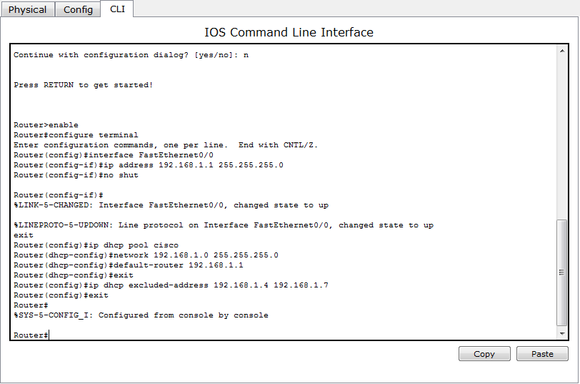

Slide 28
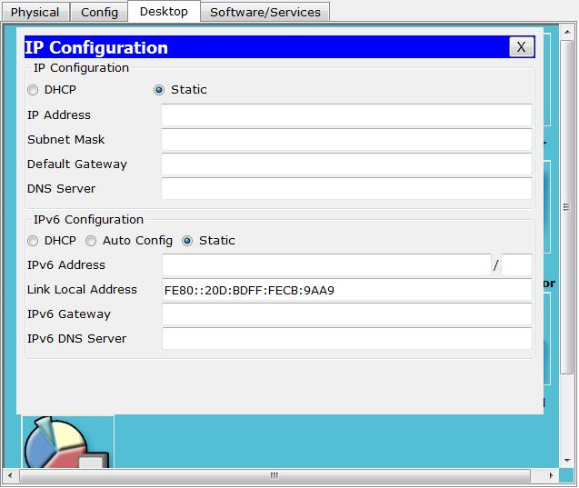

Slide 29


